Slide 1
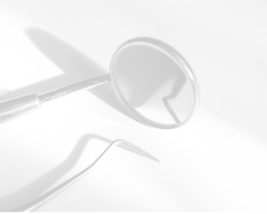
«Geosoft Dent»

Slide 2
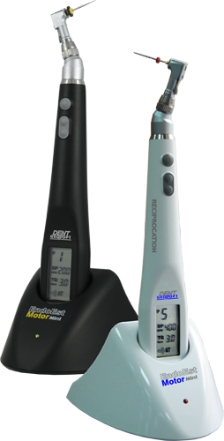
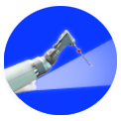
ENDODONTIC MOTOR «EndoEst Motor-Mini»

Slide 3
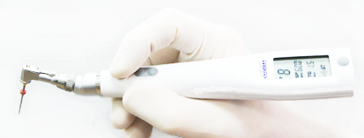
ENDODONTIC MOTOR «EndoEst Motor-Mini»
HIGH RELIABILITY PROVIDED
BY “FAULHABER” (SWITZERLAND)

Slide 4
ENDODONTIC MOTOR «EndoEst Motor-Mini»
SUITABLE FOR ALL KINDS OF
NICKEL-TITANIUM FILES

Slide 5
ENDODONTIC MOTOR «EndoEst Motor-Mini»
9 SPEED AND TORQUE COMBINATIONS

Slide 6
ENDODONTIC MOTOR «EndoEst Motor-Mini»
AUTOTVIST OR AUTOSTOP FUNCTIONS
ON FILES OVERLOADING

Slide 7
ENDODONTIC MOTOR «EndoEst Motor-Mini»
6 HOURS OF CONTINUOUS OPERATION
WITHOUT THE BATTERY RECHARGING

Slide 8
ENDODONTIC MOTOR «EndoEst Motor-Mini»
BUILT IN APEXLOCATOR DOESN’T ALLOW
GOING BEYOND THE APEX

Slide 9
ENDODONTIC MOTOR «EndoEst Motor-Mini»
RECIPROCAL FILES WORK POSSIBILITY

Slide 10
ENDODONTIC MOTOR «EndoEst Motor-Mini»
FULL WORKING AREA VIEW PROVIDED
BY MINI HEAD

Slide 11
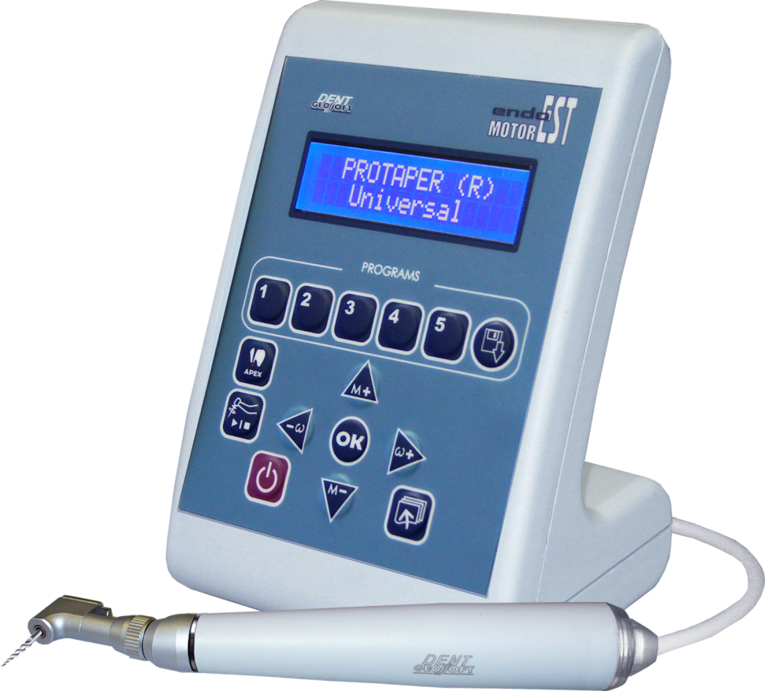
ENDODONTIC MOTOR WITH APEXLOCATOR «EndoEst-Motor»

Slide 12
ENDODONTIC MOTOR AND APEXLOCATOR «EndoEst-Motor»
ENDOMOTOR AND APEXLOCATOR ARE
IN ONE DEVICE

Slide 13
ENDODONTIC MOTOR AND APEXLOCATOR «EndoEst-Motor»
FULL WORKING AREA VIEW PROVIDED
BY MINI HEAD

Slide 14
ENDODONTIC MOTOR AND APEXLOCATOR «EndoEst-Motor»
BUILT IN APEXLOCATOR DOESN’T ALLOW
GOING BEYOND THE APEX

Slide 15
ENDODONTIC MOTOR AND APEXLOCATOR «EndoEst-Motor»
HIGH RELIABILITY PROVIDED
BY “FAULHABER” (SWITZERLAND)

Slide 16
ENDODONTIC MOTOR AND APEXLOCATOR «EndoEst-Motor»
THE HUGE PROGRAMS LIBRARY FOR
NICKEL-TITANIUM FILES SYSTEMS OF
LEADING MANUFACTURES

Slide 17
ENDODONTIC MOTOR AND APEXLOCATOR «EndoEst-Motor»
THE VIRTUAL APEX INSTALLING POSSIBILITY

Slide 18
ENDODONTIC MOTOR AND APEXLOCATOR «EndoEst-Motor»
SOFTWARE UPDATES VIA INTERNET
POSIBILITY

Slide 19
ENDODONTIC MOTOR AND APEXLOCATOR «EndoEst-Motor»
LIGHT ERGONOMIC TIP

Slide 20
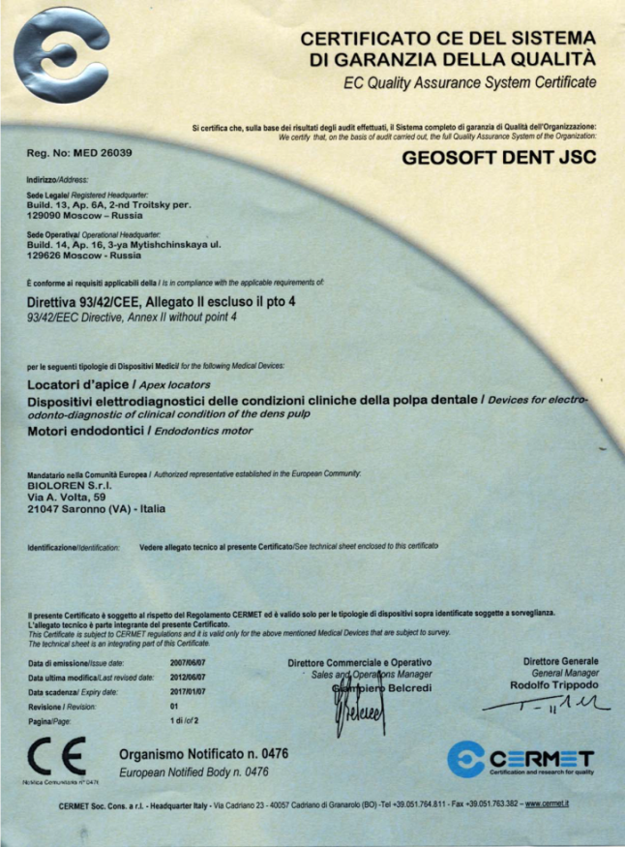
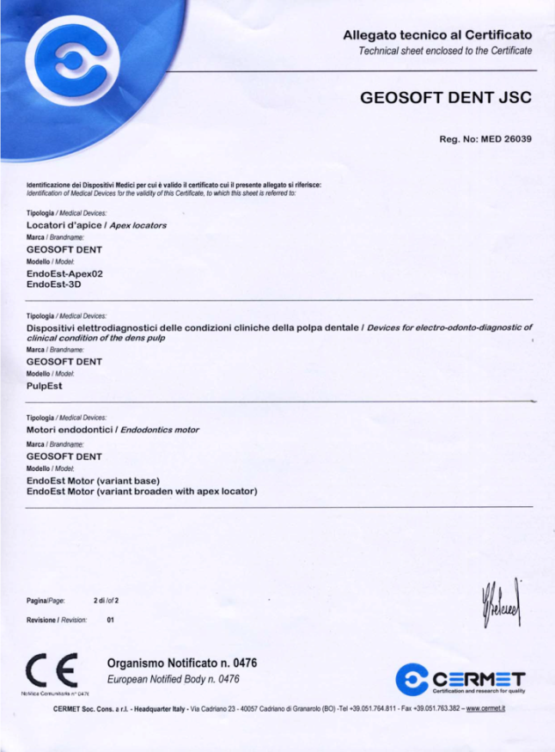
ENDODONTIC MOTOR AND APEXLOCATOR «EndoEst-Motor»
European CE Certificate of Conformity

Slide 21
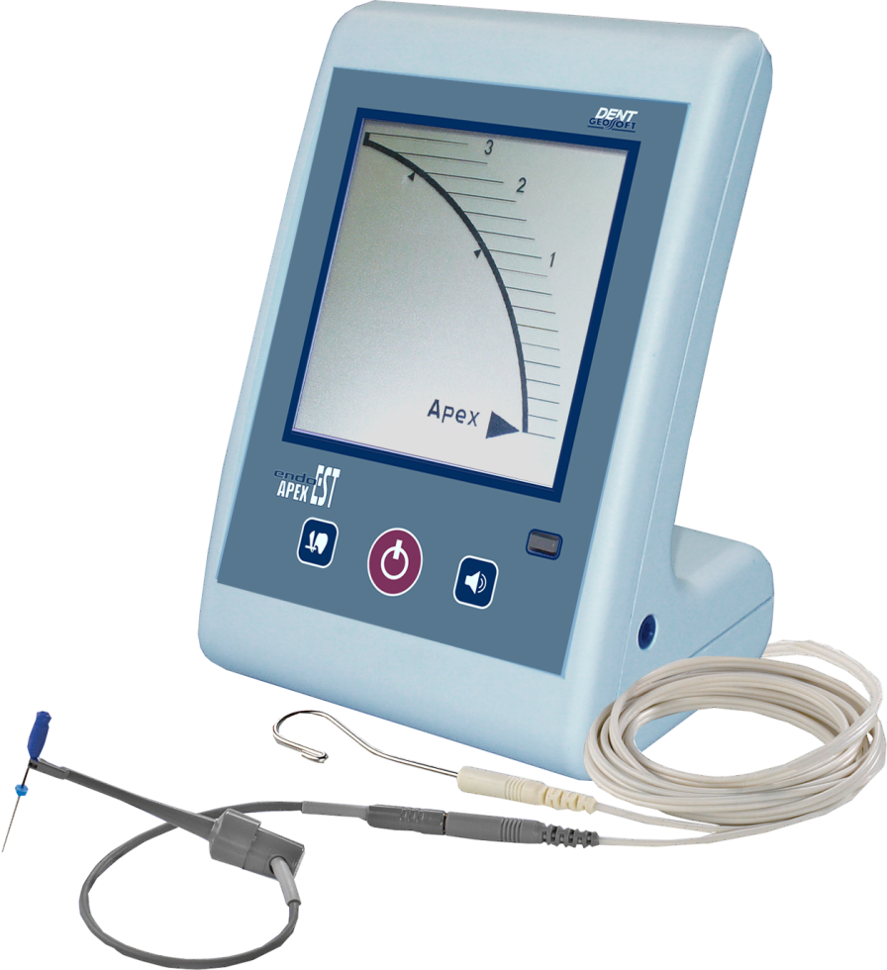
APEXLOCATOR «EndoEst-Apex02»

Slide 22
APEXLOCATOR «EndoEst-Apex02»
TIME-TESTED!
THE PROFESSIONAL DEVICE FOR TOOTH CANAL
APICAL CONSTRICTION LOCALIZATION
профессиональный аппарат для локализации апикального сужения канала зуба.
Возможность установки «виртуального апекса»

Slide 23
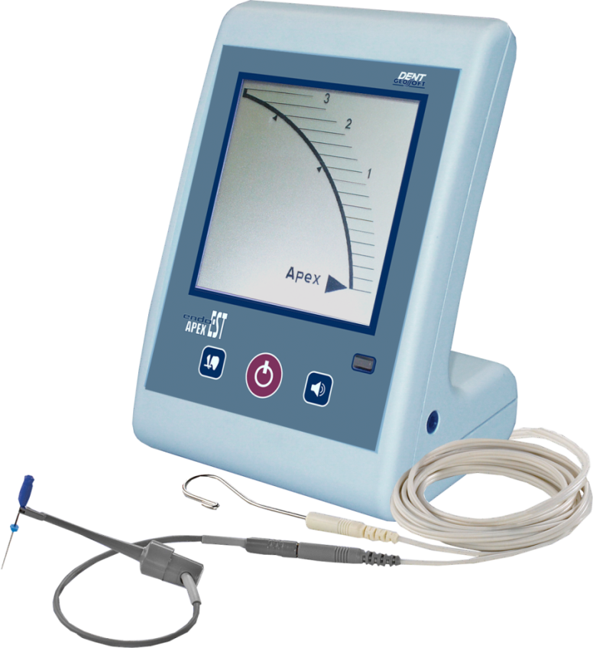
APEXLOCATOR «EndoEst-Apex02»
MULTI-FREQUENCY APEX LOCALIZATION PRINCIPLE —GUARANTEED MEASUREMENTS ACCURACY IN ALL ENVIRONMENTS
профессиональный аппарат для локализации апикального сужения канала зуба.
Возможность установки «виртуального апекса»

Slide 24
APEXLOCATOR «EndoEst-Apex02»
профессиональный аппарат для локализации апикального сужения канала зуба.
Возможность установки «виртуального апекса»
THE VIRTUAL APEX INSTALLING POSSIBILITY

Slide 25
APEXLOCATOR «EndoEst-Apex02»
профессиональный аппарат для локализации апикального сужения канала зуба.
Возможность установки «виртуального апекса»
LARGE WELL – READABLE LIQUID
CRISTAL DISPLAY

Slide 26
APEXLOCATOR «EndoEst-Apex02»
NUMERIC, GRAPHIC, LIGHT AND SOUND
RESULTS MEASUREMENT INDICATION
профессиональный аппарат для локализации апикального сужения канала зуба.
Возможность установки «виртуального апекса»

Slide 27
APEXLOCATOR «EndoEst-Apex02»
AUTOMATIC TURN ON WHEN THE WORKING FILE
IS INTRODUCED IN THE TOOTH CANAL
профессиональный аппарат для локализации апикального сужения канала зуба.
Возможность установки «виртуального апекса»

Slide 28
APEXLOCATOR «EndoEst-Apex02»
THE CANAL HUMIDITY LEVEL INDICATION
("DRY" OR "WET")
профессиональный аппарат для локализации апикального сужения канала зуба.
Возможность установки «виртуального апекса»

Slide 29
APEXLOCATOR «EndoEst-Apex02»
профессиональный аппарат для локализации апикального сужения канала зуба.
Возможность установки «виртуального апекса»
THE APICAL STOP FORMING FUNCTION
(VIRTUAL APEX LOCALIZATION)

Slide 30
APEXLOCATOR «EndoEst-Apex02»
профессиональный аппарат для локализации апикального сужения канала зуба.
Возможность установки «виртуального апекса»
BATTERY LOW POWER INDICATION

Slide 31
APEXLOCATOR «EndoEst-Apex02»
профессиональный аппарат для локализации апикального сужения канала зуба.
Возможность установки «виртуального апекса»
POWER SAVING FUNCTION

Slide 32
APEXLOCATOR «EndoEst-Apex02»
European CE Certificate of Conformity

Slide 33
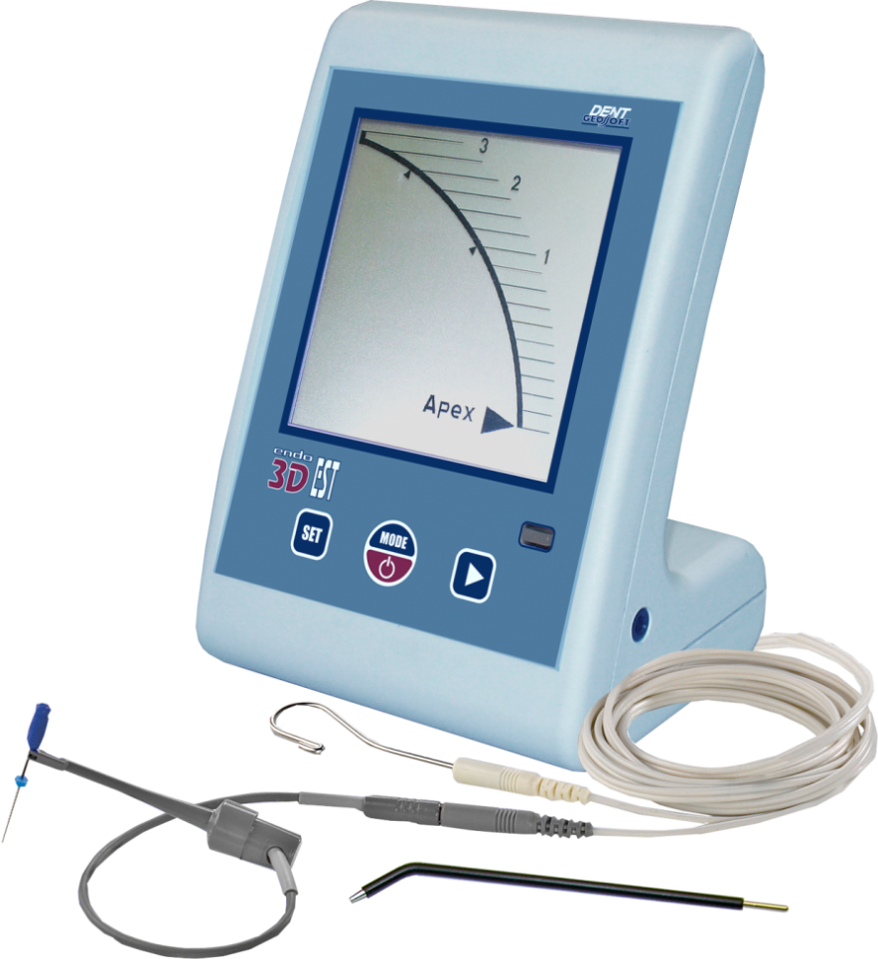
DIAGNOSTIC ENDODONTIC DEVICE «EndoEst-3D»

Slide 34
DIAGNOSTIC ENDODONTIC DEVICE «EndoEst-3D»
THREE FUNCTIONS IN ONE DEVICE!
1. APEXLOCATOR(АРЕХ) — LOCALIZATION OF THE ROOT
CANAL TOOTH APICAL CONSTRICTION (APEX)
2. ELECTROODONTODIAGNOSIS (EOD)-DETERMINATION OF
THE TOOTH PULP CLINICAL CONDITION
3. DENTOMETR (PULP) – THE DETERMINATION OF
VITAL TEETH OVER PULP DENTIN THICKNESS

Slide 35
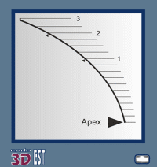
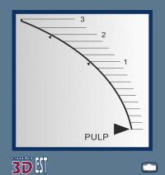
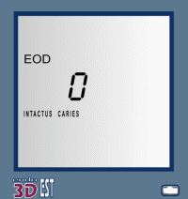
DIAGNOSTIC ENDODONTIC DEVICE «EndoEst-3D»
Large well-readable Liquid Cristal Display
Арех»Mode
Multi-frequency Apex Localization Principle —Guaranteed Measurements Accuracy
in all Environments
The canal humidity level indication («WET») in «АРЕХ»Mode
The Virtual APEX Installing Possibility
Three speeds of “diagnostic current” increasing depending on the intended tested
tooth pulp condition in EOD mode.
The display diagnosis output in the current value dependence corresponding
to the patients' pain threshold in “EOD “Mode”
«PULP»Mode
Graphic, Light and Sound Indication in all operation modes.
Battery Low Power Indication
Power Saving Function.
Further preparation is possible.
The preparation is to stop.
The pulp viability threat.
«EOD»Mode

Slide 36
DIAGNOSTIC ENDODONTIC DEVICE «EndoEst-3D»
European CE Certificate of Conformity

Slide 37
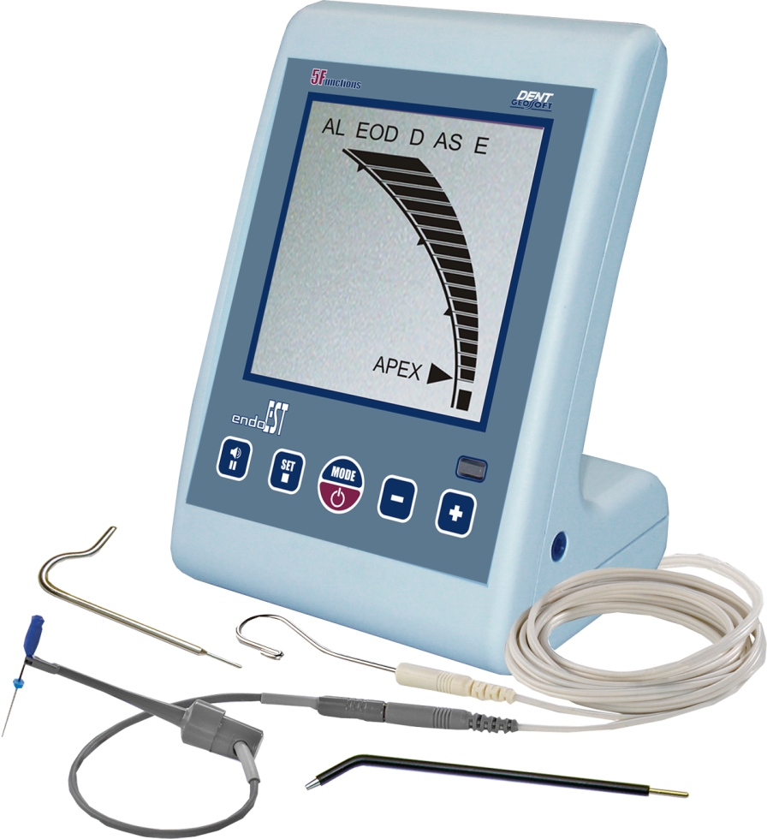
TREATMENT-DIAGNOSTIC ENDODONTIC DEVICE «EndoEst»

Slide 38
TREATMENT-DIAGNOSTIC ENDODONTIC DEVICE «EndoEst»
FIVE FUNCTIONS IN ONE DEVICE!
APEXLOCATOR (АL) — LOCALIZATION OF THE TOOTH ROOT CANAL APICAL CONSTRICTION (APEX)
ELECTROODONTODIAGNOSIS (EOD)-DETERMINATION OF THE TOOTH PULP
CLINICAL CONDITION
DEPOPHORESIS (D) — DEPOPHORESIS OF COOPER – CALCIUM HYDROXIDE UNDER A LICENCE FROM THE«HUMANCHEMIE»GMBH.
АNODE STERILIZATION(AS) — A ROOT CANAL STERILIZATION BY
DIRECT CURRENT.
ELECTROPHORESIS(Е) — ELECTROPHORESIS OF MEDICAL
SUBSTANCES IN THE TOOTH ROOT CANAL AND PERIODONTIUM

Slide 39
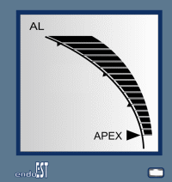
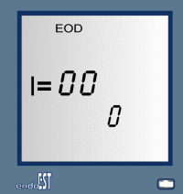
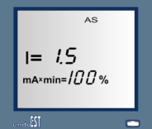
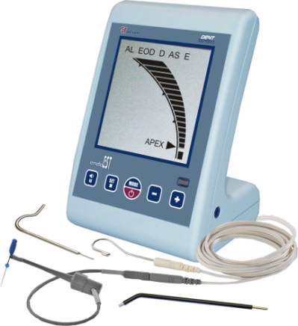
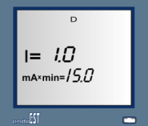
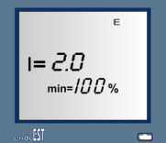
TREATMENT-DIAGNOSTIC ENDODONTIC DEVICE «EndoEst»
«Арех»Mode
FIVE FUNCTIONS IN ONE DEVICE
MULTI-FREQUENCY APEX LOCALIZATION PRINCIPLE —GUARANTEED
MEASUREMENTS ACCURACY IN ALL ENVIRONMENTS
THE CANAL HUMIDITY LEVEL INDICATION(«WET») IN «АРЕХ»MODE
LARGE WELL-READABLE LIQUID CRISTAL DISPLAY
«EOD»Mode
THE SOUND SIGNAL VOLUME LEVEL ADJUSTMENT
THE APICAL STOP FORMING FUNCTION IN«АРЕХ» MODE
GRAPHIC, LIGHT AND SOUND INDICATION IN ALL OPERATION MODES
BATTERY LOW POWER INDICATION
POWER SAVING FUNCTION.
«AS»Mode
INTACTUS
CARIES
PULPITIS
NECROSIS PULPAE CORONAE
NECROSIS PULPAE RADIALIS
PERIODONTIS
«D»Mode
«E»Mode

Slide 40
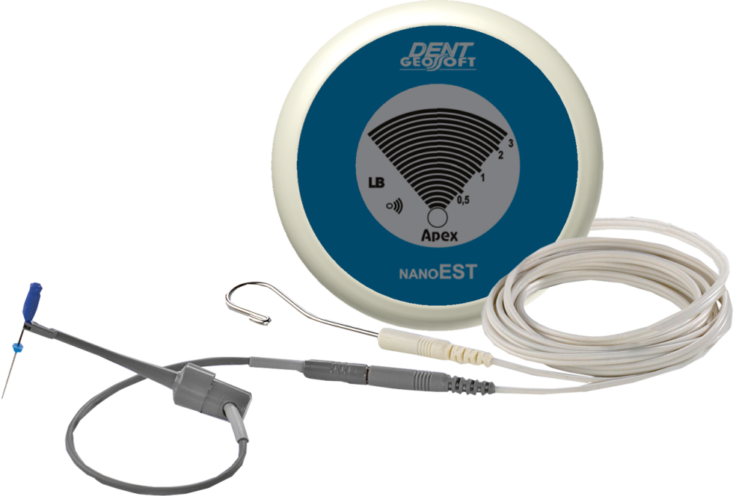
APEXLOCATOR «NanoEst»

Slide 41
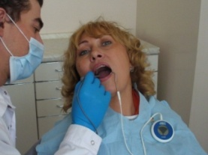
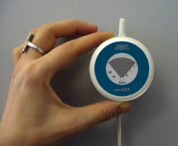
APEXLOCATOR «NanoEst»
THE 6-GENERATION APEXLOCATOR

Slide 42
APEXLOCATOR «NanoEst»
GUARANTEED MEASUREMENTS ACCURACY
AND STABILITY IN ALL ENVIRONMENTS

Slide 43
APEXLOCATOR «NanoEst»
MINI SIZE AND LIGHT WEIGHT

Slide 44
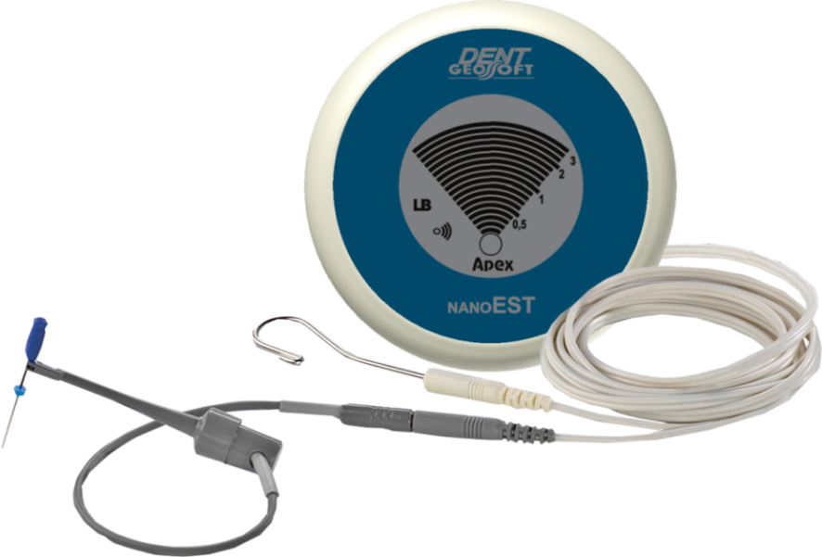
APEXLOCATOR «NanoEst»
THE POSSIBILITY OF BEING FIXED ON THE PATIENT HYGIENIC APRON ENABLES THE DEVICE TO BE ALWAYS IN THE DENTIST OPERATING ZONE

Slide 45
APEXLOCATOR «NanoEst»
THE HIGHEST LEVEL OF THE PATIENTS’
SAFETY IS ACHIEVED

Slide 46
APEXLOCATOR «NanoEst»
SOUND LEVEL ADJUSTMENT

Slide 47
APEXLOCATOR «NanoEst»
BATTERY LOW POWER INDICATION
POWER SAVING FUNCTION

Slide 48
APEXLOCATOR «NanoEst»
THE APICAL STOP FORMING FUNCTION
(VIRTUAL APEX LOCALIZATION)

Slide 49
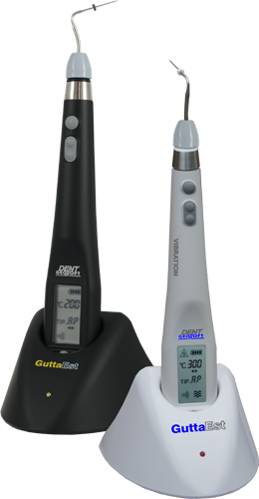
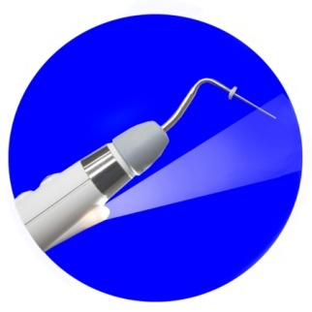
THE TOOTH ROOT CANAL HOT OBTURATION AND ENDOAC
TIVATION DEVICE «GuttaEst-V» и «GuttaEst-М»

Slide 50
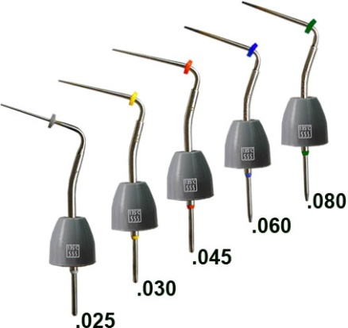
THE TOOTH ROOT CANAL HOT OBTURATION AND ENDOAC
TIVATION DEVICE «GuttaEst-V» и «GuttaEst-М»
RELIABLE ROOT CANAL OBTURATION
BY ONE DEVICE
Sterilizable small taper pluggers
6 fixed unit positions

Slide 51
THE TOOTH ROOT CANAL HOT OBTURATION AND ENDOAC
TIVATION DEVICE «GuttaEst-V» и «GuttaEst-М»
LOW PRICE. PRACTICAL. CONVENIENT.
Sterilizable small taper pluggers
6 fixed unit positions

Slide 52
THE TOOTH ROOT CANAL HOT OBTURATION AND ENDOAC
TIVATION DEVICE «GuttaEst-V» и «GuttaEst-М»
+ INSIDE CANAL HEATING OF
IRRIGATION SOLUTION
+ POSSIBILITY OF GUTTA PERCHA REMOVING
Sterilizable small taper pluggers
6 fixed unit positions

Slide 53
THE TOOTH ROOT CANAL HOT OBTURATION AND ENDOAC
TIVATION DEVICE «GuttaEst-V» и «GuttaEst-М»
SMOOTH AND ACCURATE WORKING
TEMPERATURE SETTING (FROM 50ºС TILL 300ºС)
Sterilizable small taper pluggers
6 fixed unit positions

Slide 54
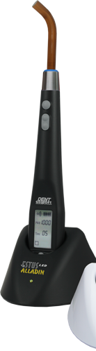
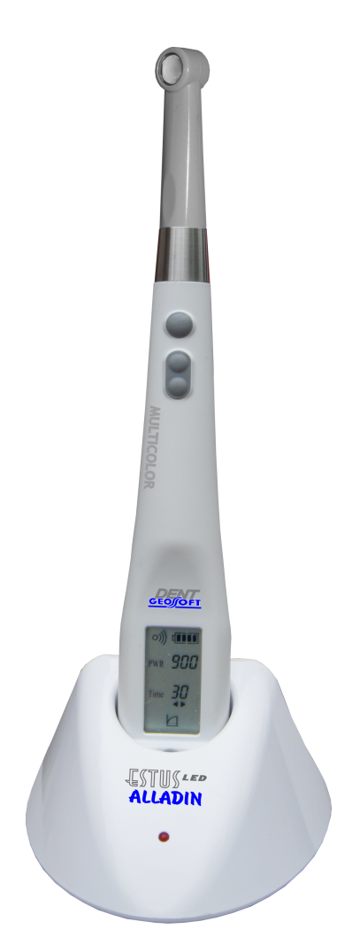
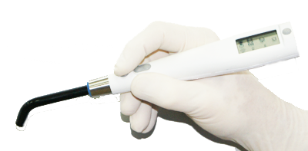
LED PHOTOACTIVATOR «EstusLED-Alladin»
CLASSIC STERILIZED OPTICAL FIBER
WITH THE 360ºROTATION POSSIBILITY
Normal mild start pulse
Wireless dental LED photoactivator for composite light-curing filling materials polymerization

Slide 55
LED PHOTOACTIVATOR «EstusLED-Alladin»

Slide 56
LED PHOTOACTIVATOR «EstusLED-Alladin»
ALL SELECTED SETTINGS LCD DISPLAY
Normal mild start pulse
Wireless dental LED photoactivator for composite light-curing filling materials polymerization

Slide 57
LED PHOTOACTIVATOR «EstusLED-Alladin»
3 POLYMERIZATION MODES:
«NORMAL», «MILD START» AND «PULSE»
Normal mild start pulse
Wireless dental LED photoactivator for composite light-curing filling materials polymerization

Slide 58
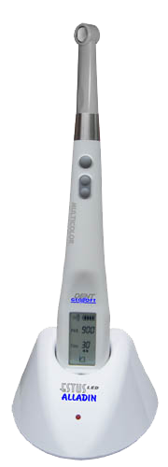
DENTAL LED PHOTOACTIVATOR «EstusLED-Alladin»
Multicolor
REMOVABLE PLASTIC LED TIP INSTEAD OF FIBER
WITH THE 360ºROTATION POSSIBILITY
THE INCREASED TRANSMITTER OUTPUT POWER
(TILL 1500 MW/SM2 )
Polymerization
of tip «ESTUS LED - BLUE»
Trans-illumination
of tip «ESTUS LED - ORANGE»
Photo disinfection
of tip «ESTUS LED - RED»
Ultraviolet diagnosis
of tip «ESTUS LED - UVА»
Multicolor
WIRELESS DENTAL MULTIFUNCTIONAL UNIT.
IMPROVED MODEL OF PHOTOACTIVATOR «Estus LED-Alladin»

Slide 59
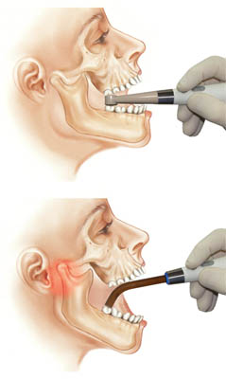
DENTAL LED PHOTOACTIVATOR «EstusLED-Alladin»
Multicolor
- FLAT TIP DESIGN FACILITATES THE ACCESS TO THE
PATIENT’S “CHEWING” TEETH GROUP
- AUTOMATIC AJUSTED TIP TYPE DEFINITION
Multicolor
WIRELESS DENTAL MULTIFUNCTIONAL UNIT.
IMPROVED MODEL OF PHOTOACTIVATOR «Estus LED-Alladin»

Slide 60
DENTAL LED PHOTOACTIVATOR «EstusLED-Alladin»
Multicolor
THREE ADDITIONAL FUNCTIONS IMPLEMENTED
WHEN USING SPECIAL TIPS (TRANS-ILLUMINATION,
PHOTO DISINFECTION AND ULTRAVIOLET DIAGNOSIS)
Multicolor
WIRELESS DENTAL MULTIFUNCTIONAL UNIT.
IMPROVED MODEL OF PHOTOACTIVATOR «Estus LED-Alladin»

Slide 61
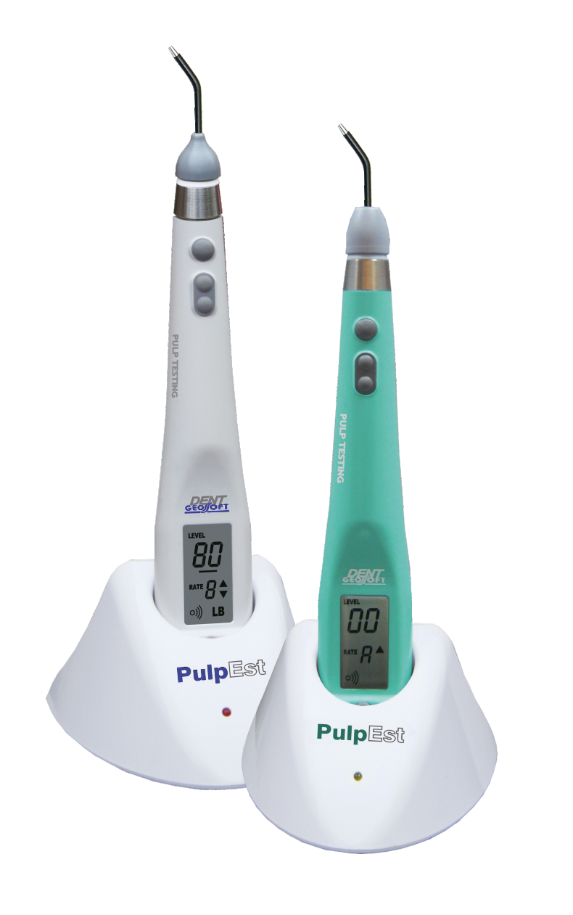
ELECTRO-DIAGNOSTIC DEVICE «PulpEst»

Slide 62
ELECTRO-DIAGNOSTIC DEVICE «PulpEst»
WIRELESS DEVICE, DESIGNED TO DETERMINE
THE CLINICAL TOOTH PULP CONDITION – ELECTROODONTODIAGNOSIS (EOD)
- Power supply: Li-Ро battery; - “Diagnostic” currents range: from 0 till 80 у.е.
Advantages: - Quick-disconnected sterilized tip probe,
6 fixed setting positions - All selected settings LSD display ; - 10 speed “diagnostic” current rising levels including “Auto” Mode,
- 20 –hours of continuous use without the battery recharging; - Small weight and dimensions

Slide 63
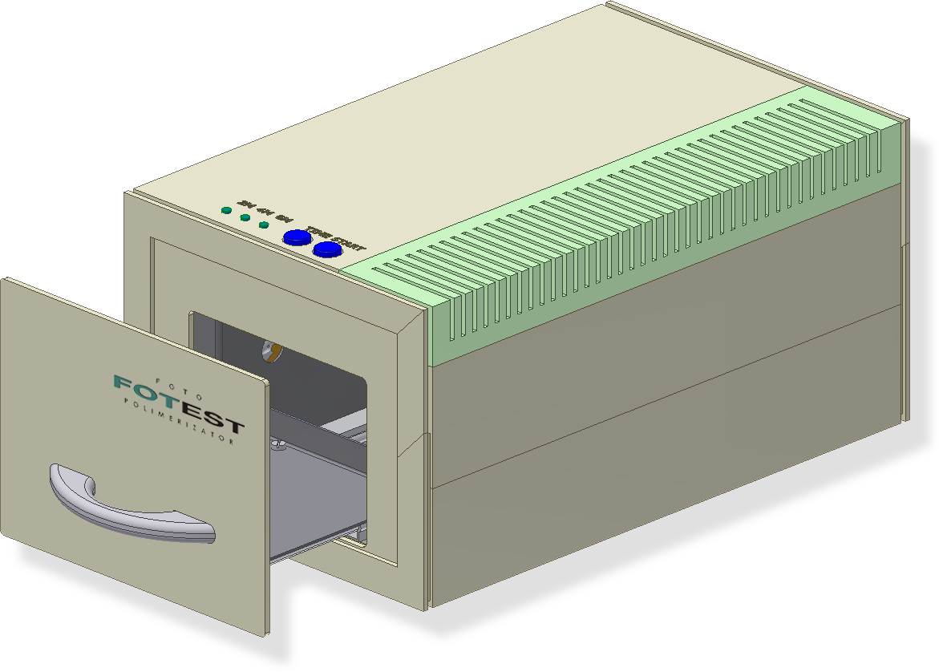
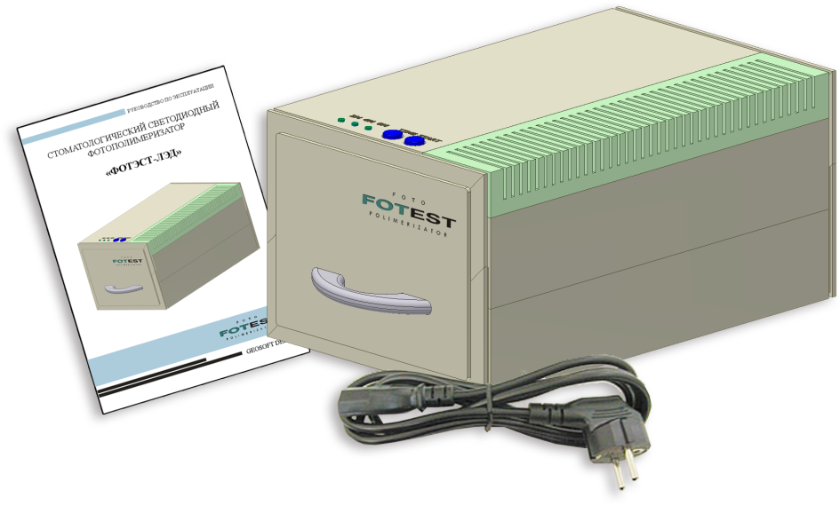
LABORATORY FOTOPOLIMERIZATOR «FotEst-LED»

Slide 64
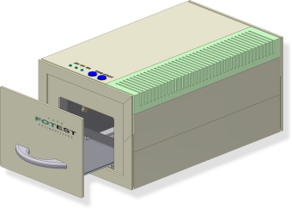
LABORATORY FOTOPOLIMERIZATOR «FotEst-LED»
USED FOR COATING
IN JACKET CROWNS MANUFACTURING INCLUDING PLASTER MODELS
IN PROSTHESIS RESTORATION
IN INLAYS AND VENEERS MANUFACTURING USED IN THERAPEUTIC DENTAL PRACTICE

Slide 65
LABORATORY FOTOPOLIMERIZATOR «FotEst-LED»
TWO RADIATOR TYPES:
12 LEDS (PRINCIPALSOURCE) AND 1 HALOGEN LAMP
(ADDITIONAL TRANSMITTING SOURCE ALLOWING POLIMERIZATION PROCESS WITH DENTAL PROSTHETIС HEATING)

Slide 66
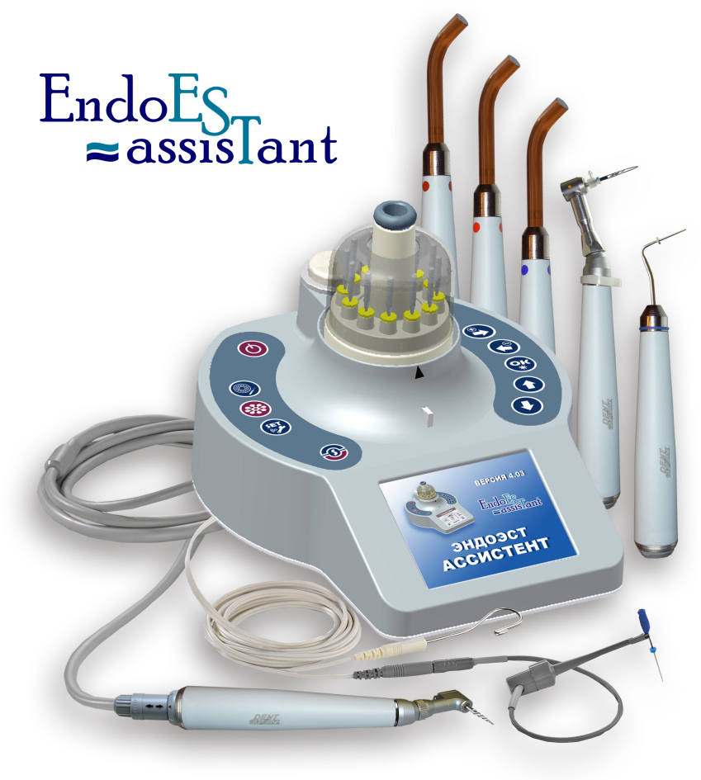
INTEGRATED ENDODONTIC COMPLEX
«EndoEst-Assistant»

Slide 67
INTEGRATED ENDODONTIC COMPLEX
«EndoEst-Assistant»
ENDOMOTOR WITH INTEGRATED APEXLOCATOR
AND AUTOMATIC WORKING FILES “FEED” SYSTEM
Independent apexlocator
Root canal filler
Thermoplugger for obturation
Trans-illumination, polymerization,
oral photo-disinfection lamp
Negatoscope.

Slide 68
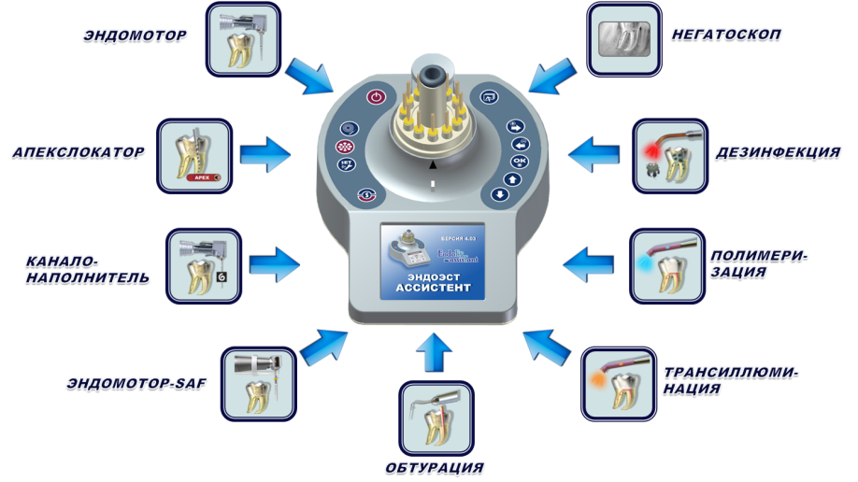
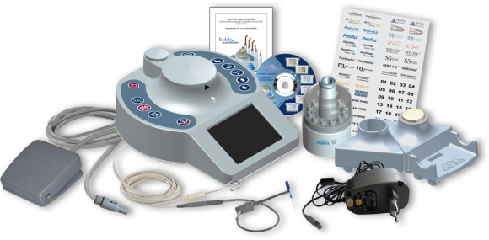
INTEGRATED ENDODONTIC COMPLEX
«EndoEst-Assistant»
The implementation of almost all endodontic line of instruments in one device.
7 removable working attachments. Automatic reconfiguration system into the device corresponded to the connected working attachment.
The possibility of constant functional capacity through additional working attachments acquisition.
Operational software updates via the Internet.
Independent Li-lon power supply of high capacity.
Bright color display.
Minimum wires number and compact size.
Endomotor/Apexlocator/Root canal filling/ Endomotor/Negatoscope/Disinfection/Polymerization/Trans-illumination

Slide 69
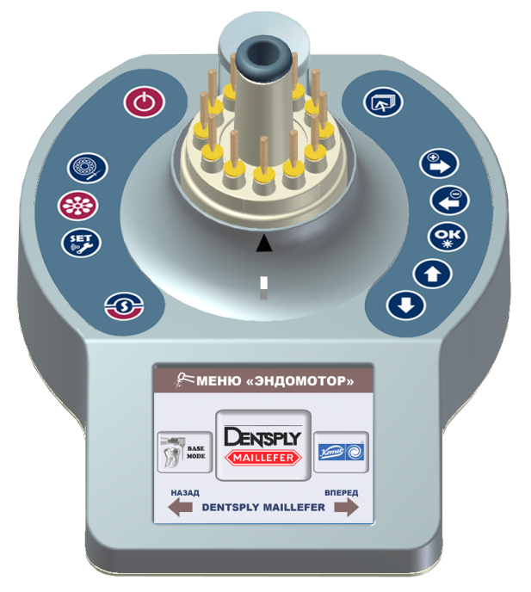
INTEGRATED ENDODONTIC COMPLEX
«EndoEst-Assistant»
THE LARGE PROGRAMS LIBRARY FOR ENDODONTIC ROTATING NI-TI
FILES SYSTEMS OF LEADING MANUFACTURES
ProTaper Universal
GT Series X
System GT
ProFile
PathFile
Wave One
RaCe & S-Apex
BioRaCe
iRaCe
Hero 642
Hero Shaper
EndoFlare
Hero Apical
Revo-S
R-Endo
AlphaKite System
EasyShape System
FlexMaster
Mtwo System
RECIPROC
NiTi-TEE
S5 Endo Files
Twisted Files
К3 Endo
CMA System

Slide 70
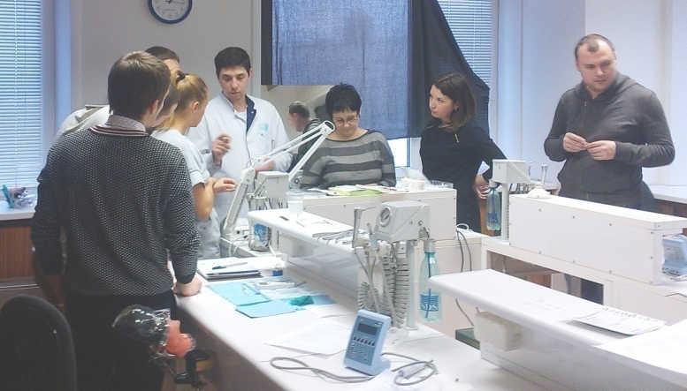
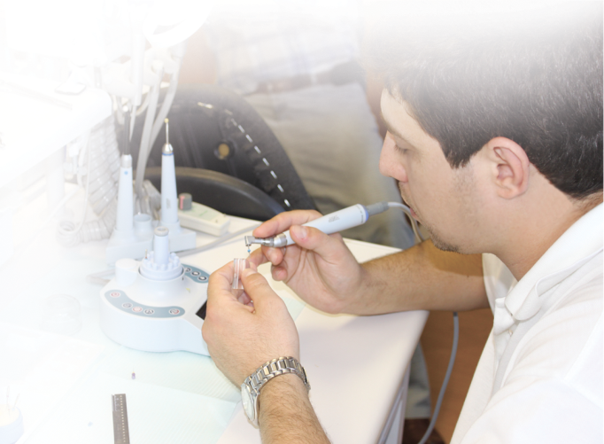
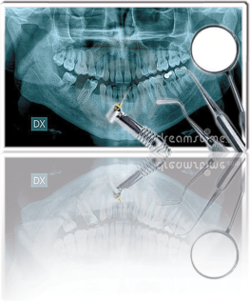
INTEGRATED ENDODONTIC COMPLEX
«EndoEst-Assistant»
AS A GIFT TO THE ENDOEST MOTORS AND ENDOEST-ASSISTANT
– CERTIFICATE FOR ENDODONTICS TRAINING
+
СERTIFICATE
FOR ENDODONTICS TRAINING

Slide 71
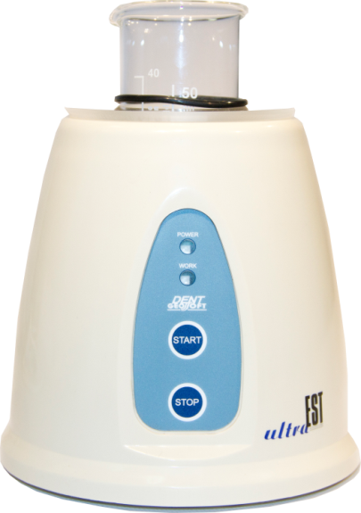
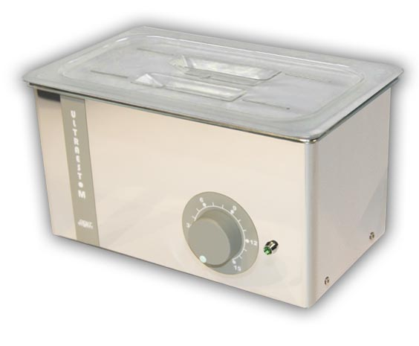
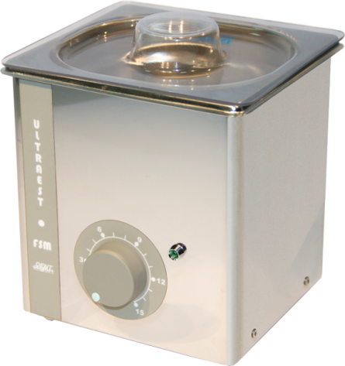
ULTRASOUND BATHS
«UltraEst», «UltraEst-М», «UltraEst -FSM»
THE COMBINING OF PRE-STERILIZATION CLEANING
AND DISINFECTION POSSIBILITY (clinically proven)
Little time of instruments treatment
The combining of pre-sterilization cleaning and disinfection possibility in one working cycle of the unit – saving time and working solution.

Slide 72
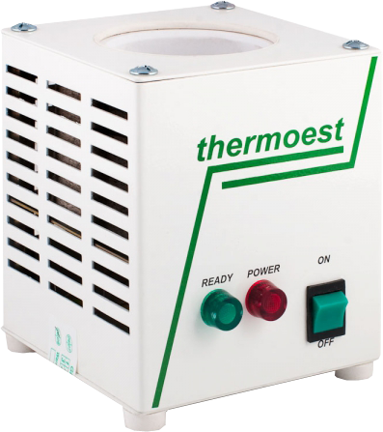
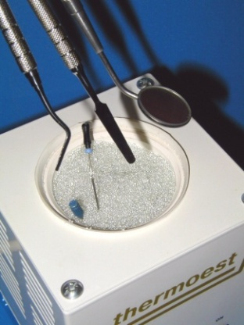
GLASS BEAD STERILIZER «ThermoEst»
DESK SIZE COMPACT GLASS BEAD STERILIZER
Quick heating and slow cooling down
Little sterilization time
from 10 sec - till 3 min
Ceramic glass provides even glass bead filler heating
Compact dimensions

Slide 73
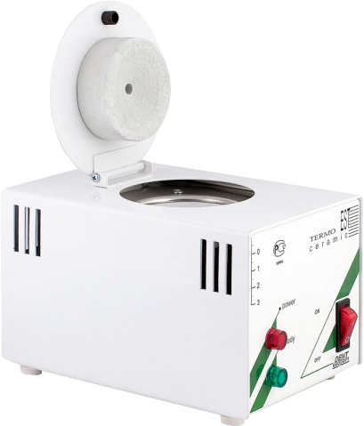
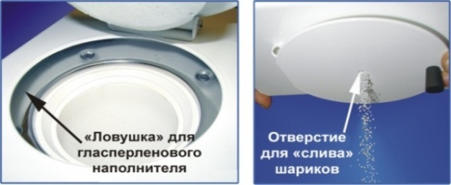
GLASS BEAD STERILIZER «ThermoEst»
DESK SIZE COMPACT GLASS BEAD STERILIZER
Quick heating and slow cooling down
Little sterilization time
(not more than 3 min)
There is a protective cover with a hole to “drain“ filler
Special protection from filler “splashing”.

Slide 74
Closed Joint Stock Company
«Geosoft Dent»

